Slide 1
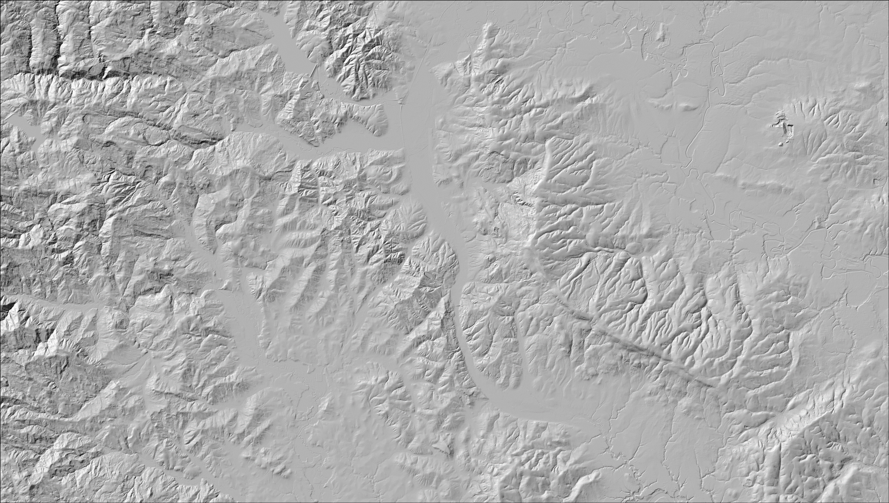
Overview of the SICCM Toolbox
Prepared by Michael Bunn, Ben Leshchinsky, and Michael Olsen with support from U.S. Forest Service grant 17-CS-11015600-008
December 2018
Notes:
The SICCM Toolbox is a collection of tools in ArcGIS that may be used to produce semi-automated landslide inventories and estimate the risk of the inventories to road networks.

Slide 2
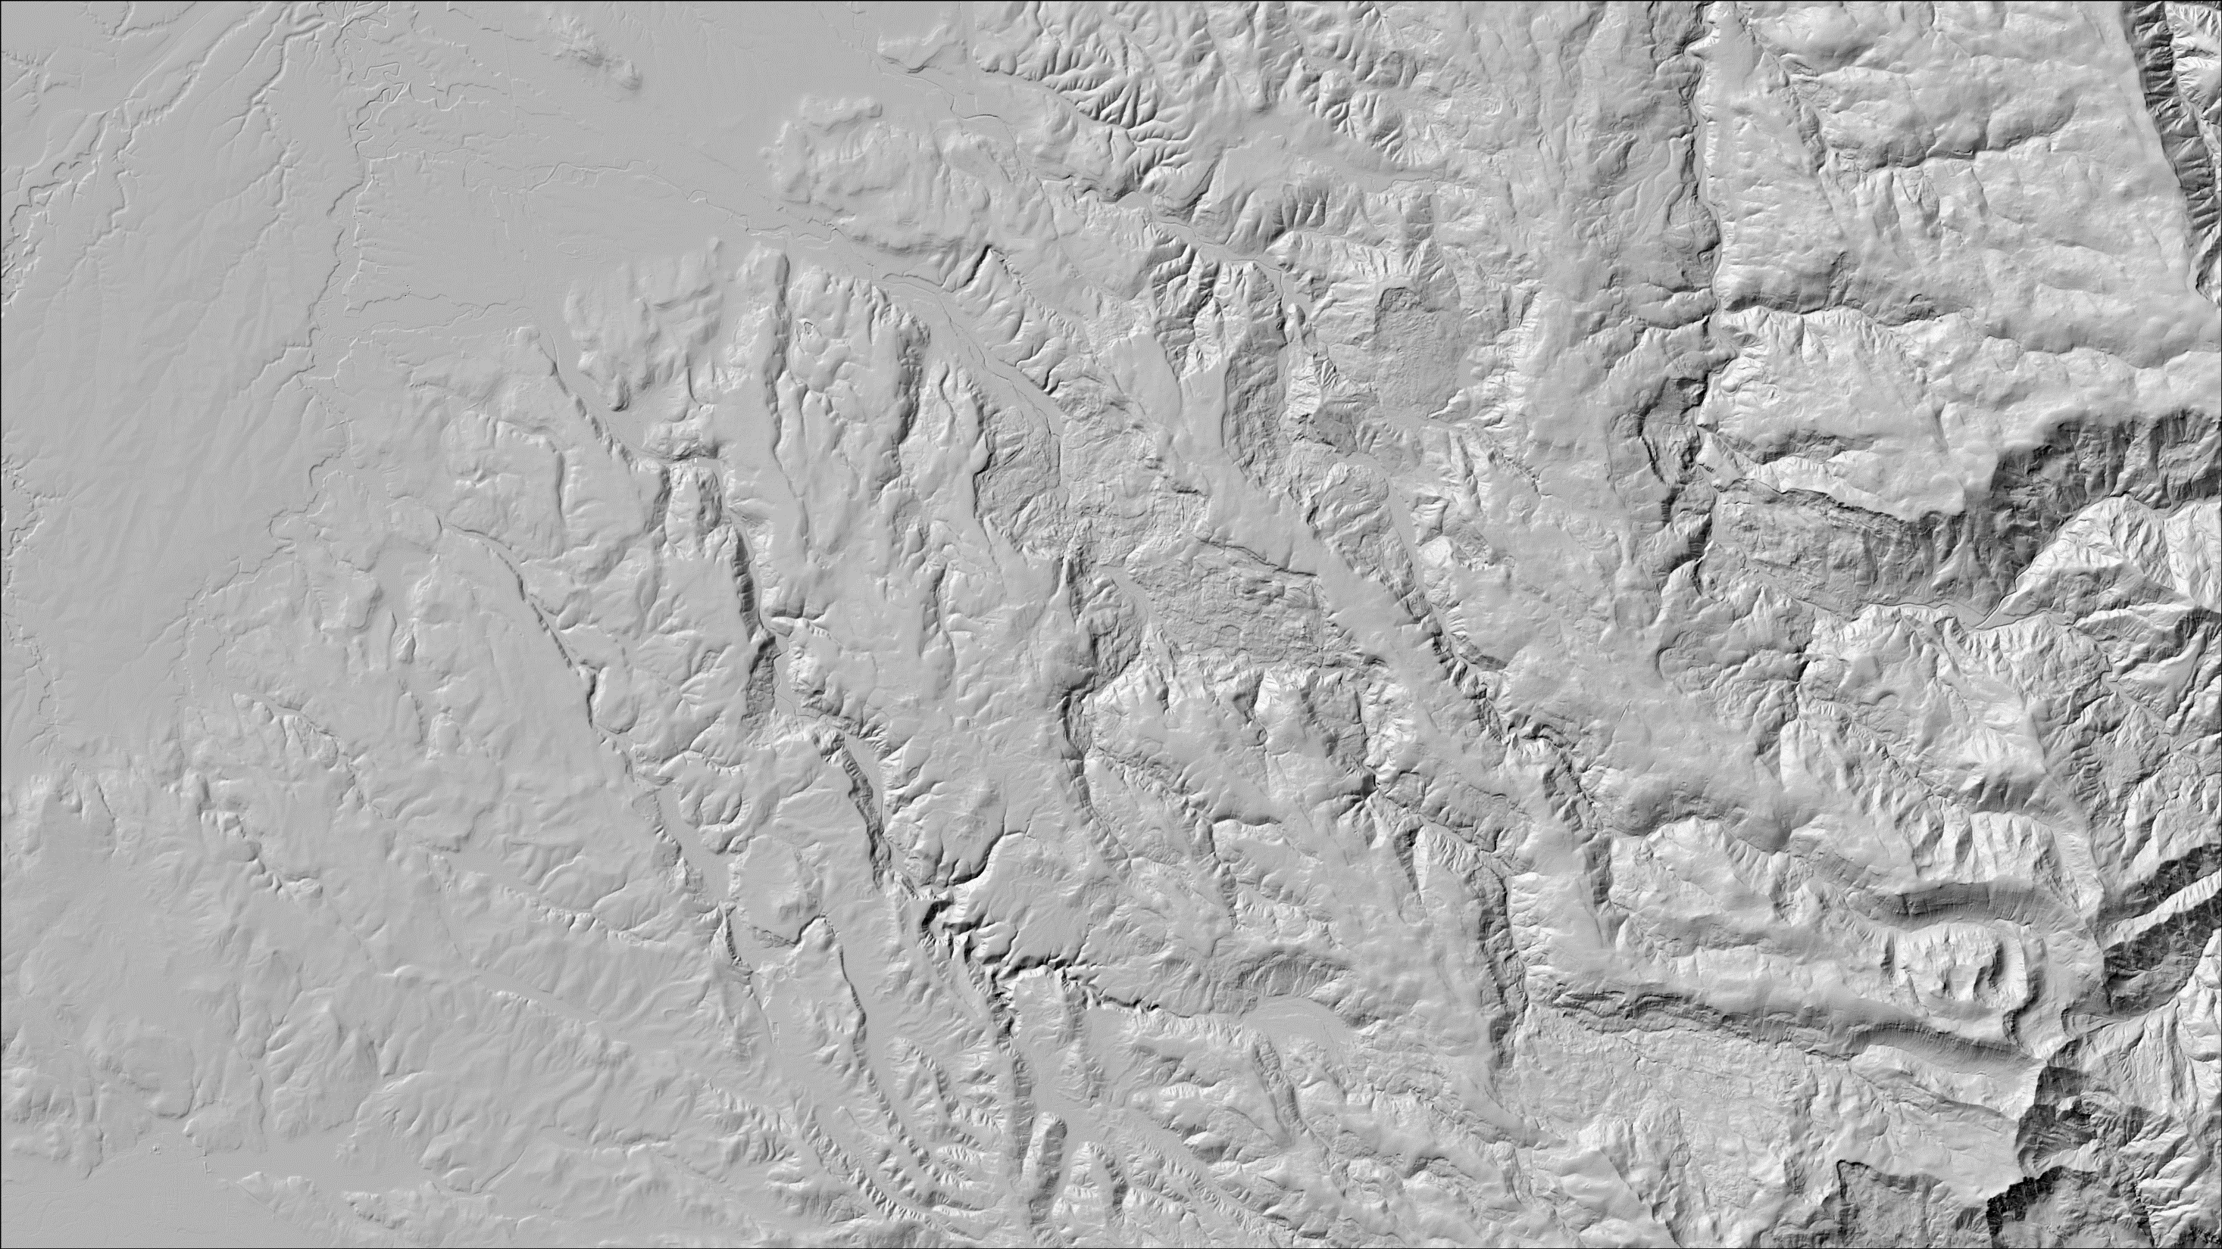
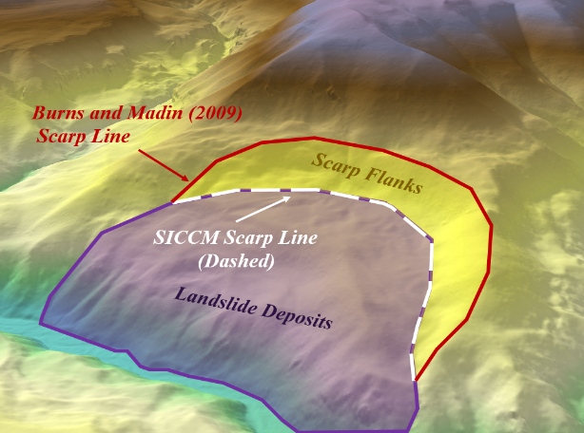
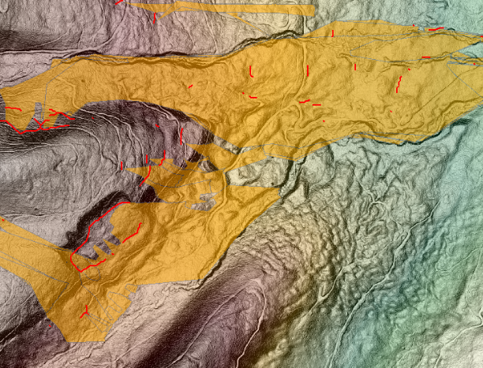
Summary of Toolbox
1
The SICCM Toolbox is an ArcGIS toolbox used to inventory landslides and quantify the risks they pose to road networks or other infrastructure/resources
The toolbox performs three main processes:
Landslide scarp identification
Landslide deposit mapping from the scarps
Risk analysis of landslide deposits on road networks
2
3
Scarp Identification Deposit Mapping Risk Analysis
Notes:
The SICCM toolbox operates through three main processes:
Landslide scarp identification
Landslide deposit mapping from the scarps
Risk analysis of landslide deposits on road networks

Slide 3
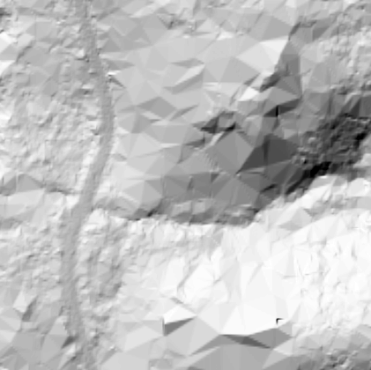
Scarp Identification Procedure
1.
The first half of SICCM – Scarp Identification – is performed in these steps:
Unwanted terrain (noise/other) is removed from digital elevation model (DEM) through resampling (coarsening resolution)
Polygons are extracted from layers derived from the resampled DEM
Polygons are classified as scarps or non scarps and converted into scarp lines
Human interpretation is recommended during scarp identification
2.
3.
Scarp Identification Deposit Mapping Risk Analysis
Notes:
The first half of SICCM – Scarp Identification – is performed in these steps:
Unwanted terrain (noise/other) is removed from digital elevation model (DEM) through resampling
Polygons are extracted from layers derived from the resampled DEM
Polygons are classified as scarps or non scarps and converted into scarp lines
Human interpretation is optional during scarp identification

Slide 4
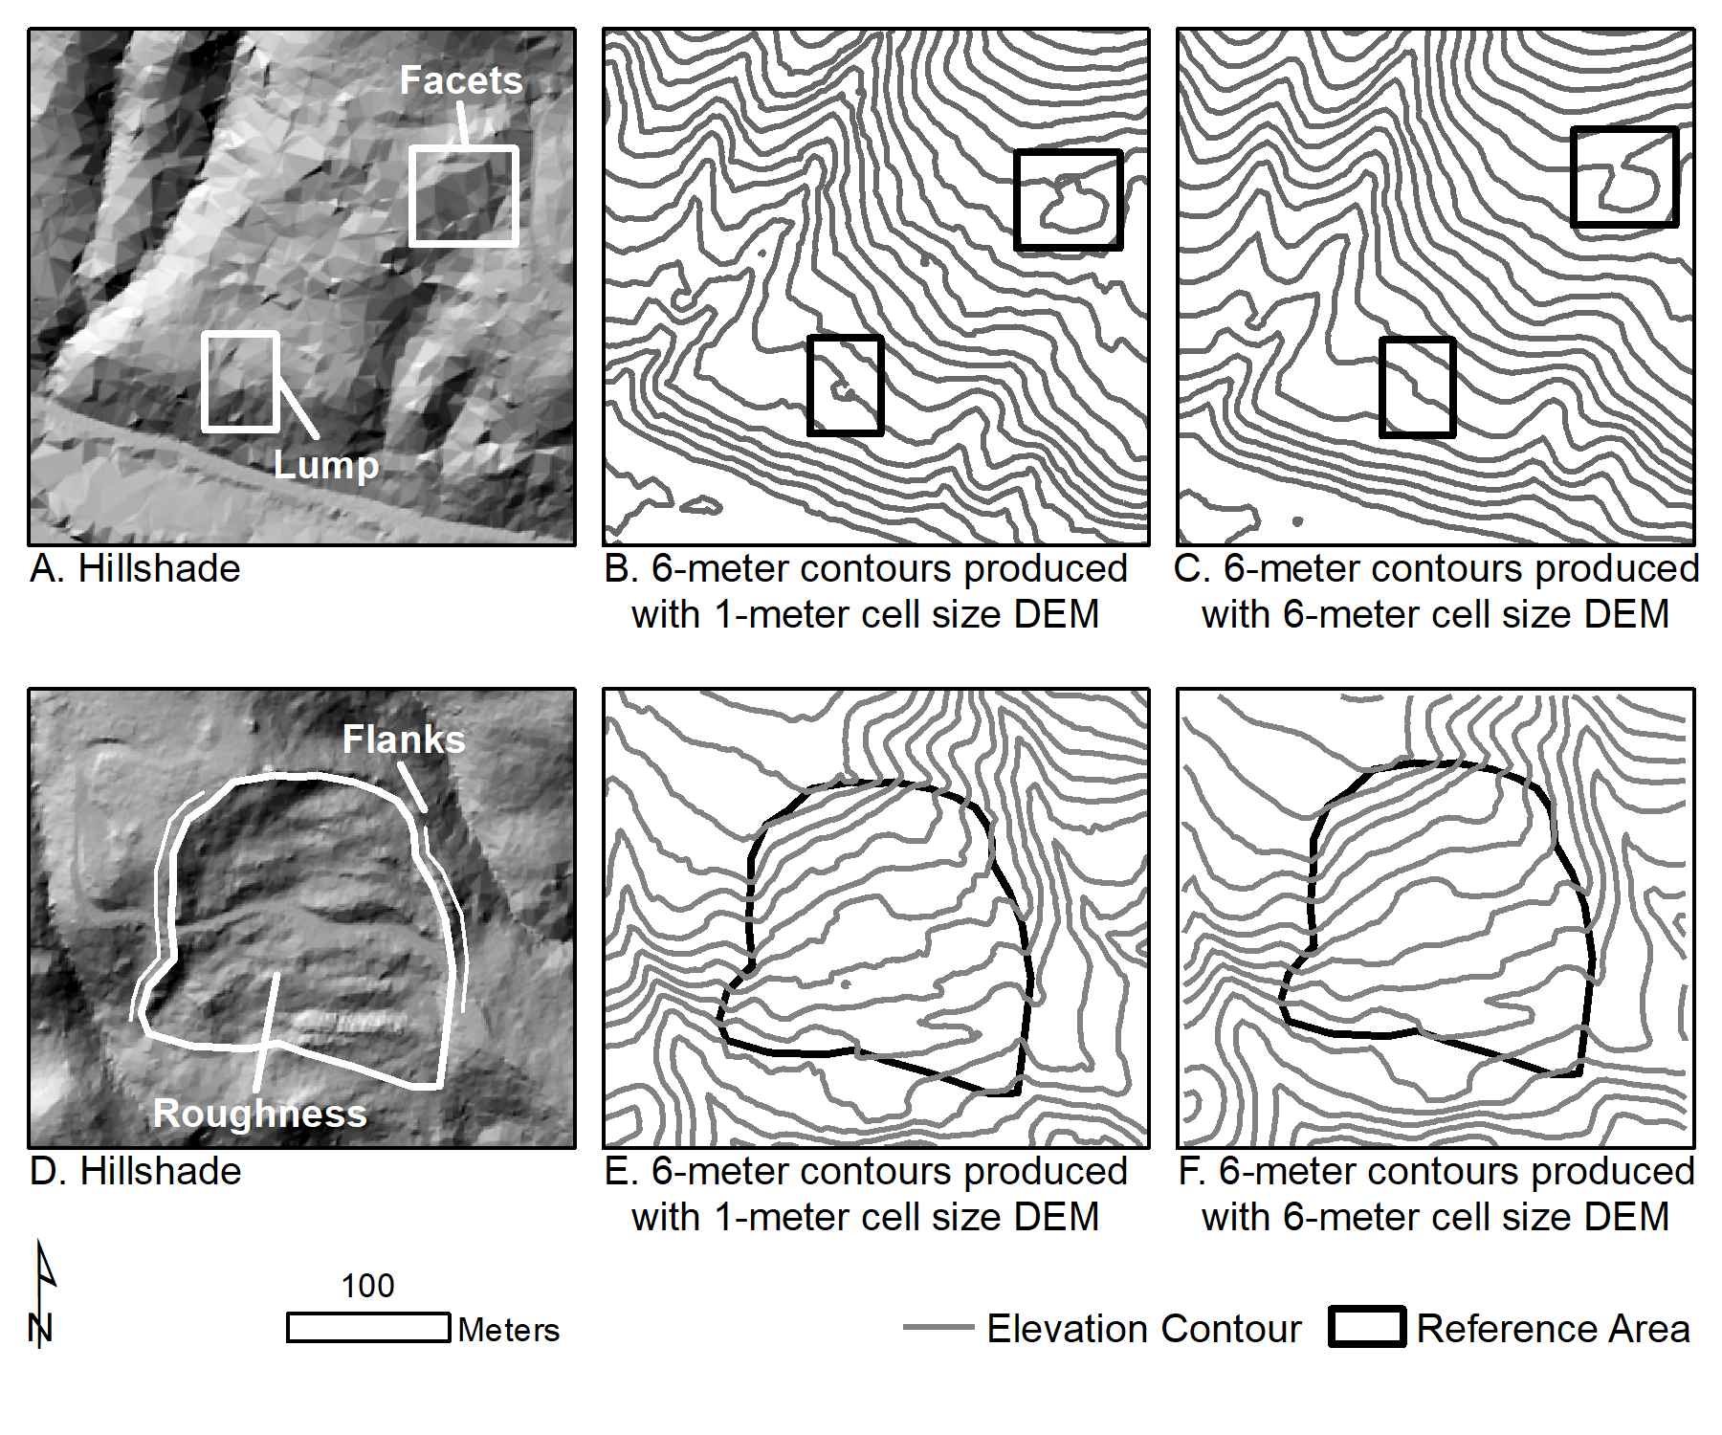
Preparation of DEM
Some DEMs have noise or other features that add error to SICCM results
These unwanted features can be removed by resampling the DEM to a lower resolution
Scarp Identification Deposit Mapping Risk Analysis
Notes:
Some DEMs have noise or other features that add error to SICCM results
These unwanted features can be removed by resampling the DEM to a lower resolution
This process is possible because unwanted features exist at a smaller scale than most landslide features

Slide 5
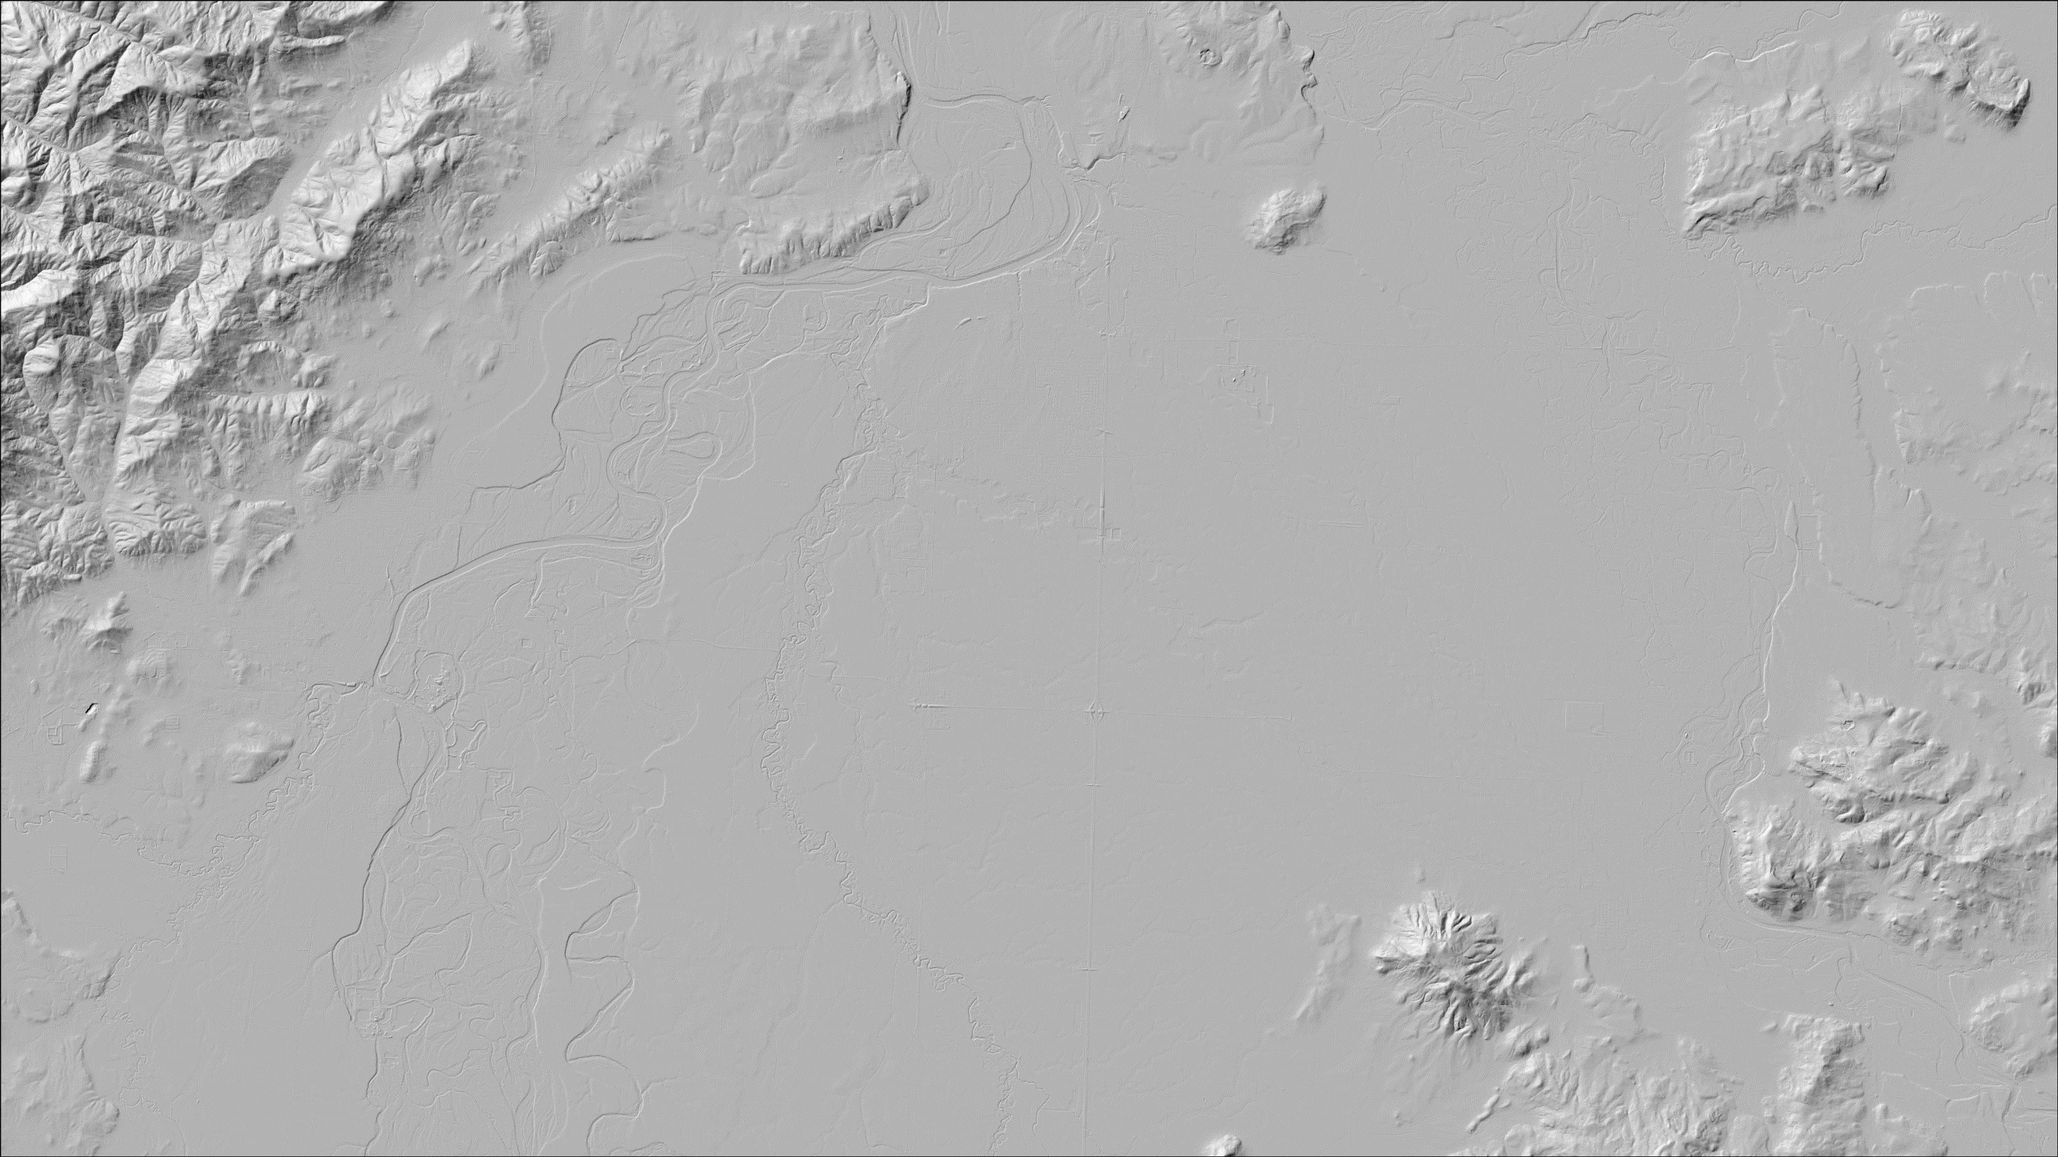
Example DEM Preparation
Best Version
Artifacts removed without
losing necessary information
Scarp Identification Deposit Mapping Risk Analysis
Notes:
Here’s an example of the DEM preparation process:
Several resolutions were computed, and the user must inspect each version.
The best resolution is the one that removes the most artifacts without losing the appearance of landslide features, such as scarps and rough, hummocky terrain.

Slide 6
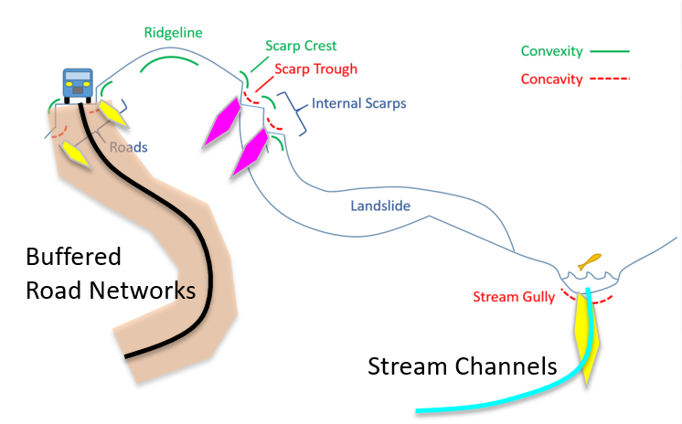
Topography of Scarps
The relationship between scarps and topography was explored
Scarps were commonly located where steep slopes met high profile curvature (convexity or concavity)
Multiplying slope and profile curvature together accentuates scarp related topography
Scarp Identification Deposit Mapping Risk Analysis
Notes:
The figure shows several common topographic features and labels them as convex or concave.

Slide 7
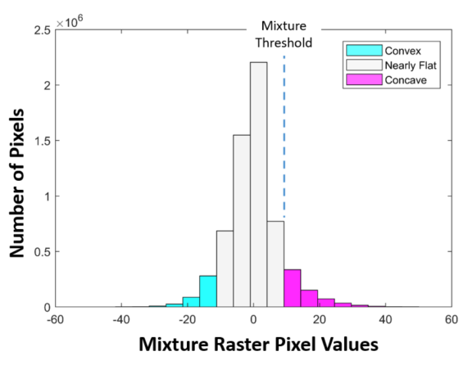
Scarp Identification Steps
Mixture raster =
slope x profile curvature
Extract mixture values to create scarp polygon candidates
Optional manual
adjustment
Notes:
Convex features were difficult to extract as individual landslides because they are often connected by the convexity of ridgelines Point out continuity of convex features in the mixture raster figure.
Concave features were chosen instead (the top right figure visualizes this distinction)
The tools automatically identify the threshold used to separate concave features, but users may make manual adjustments to fine-tune results (bottom left figure)
The result is discrete shapes corresponding to landslide scarps (bottom right)

Slide 8
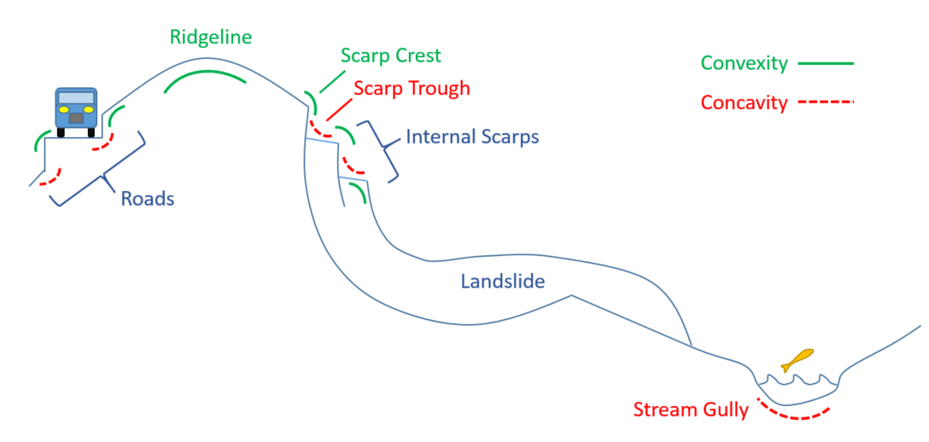
Scarp Identification (Steps 3 and 4)
Classify scarp polygons as either scarp or non-scarp based on correspondence with non-scarp objects (classes may also be chosen manually)
Reduce scarp polygons into scarp lines
Buffered
Road Networks
Stream Channels
Notes:
Classify scarp polygons as either scarp or non-scarp based on correspondence with non-scarp objects – classes may be easily changed following a quick inspection from a knowledgeable user (yellow to magenta, and vice-versa, in the figure on the right).
Reduce scarp polygons into scarp lines

Slide 9
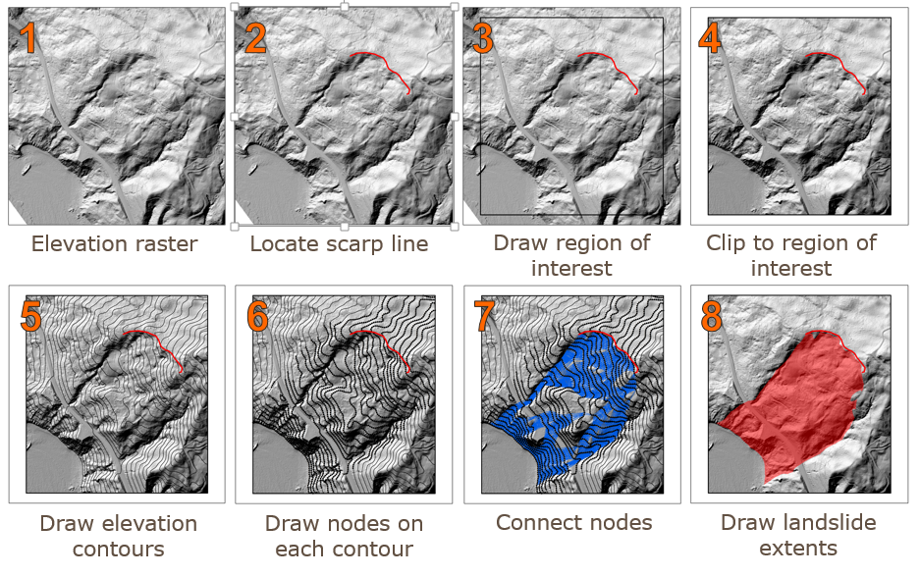
Deposit mapping with SICCM
Deposit mapping is performed with modified version of CCM
Deposit shapes rely on four user-defined inputs:
Contour Interval (Step 5)
Node Spacing (Step 6)
Active Slope and Branch Parameter (Step 7)
Scarp Identification Deposit Mapping Risk Analysis
Notes:
(Walk through each step in the figure)
The shape of the contour/connection/node mesh is dictated by four user defined inputs.

Slide 10
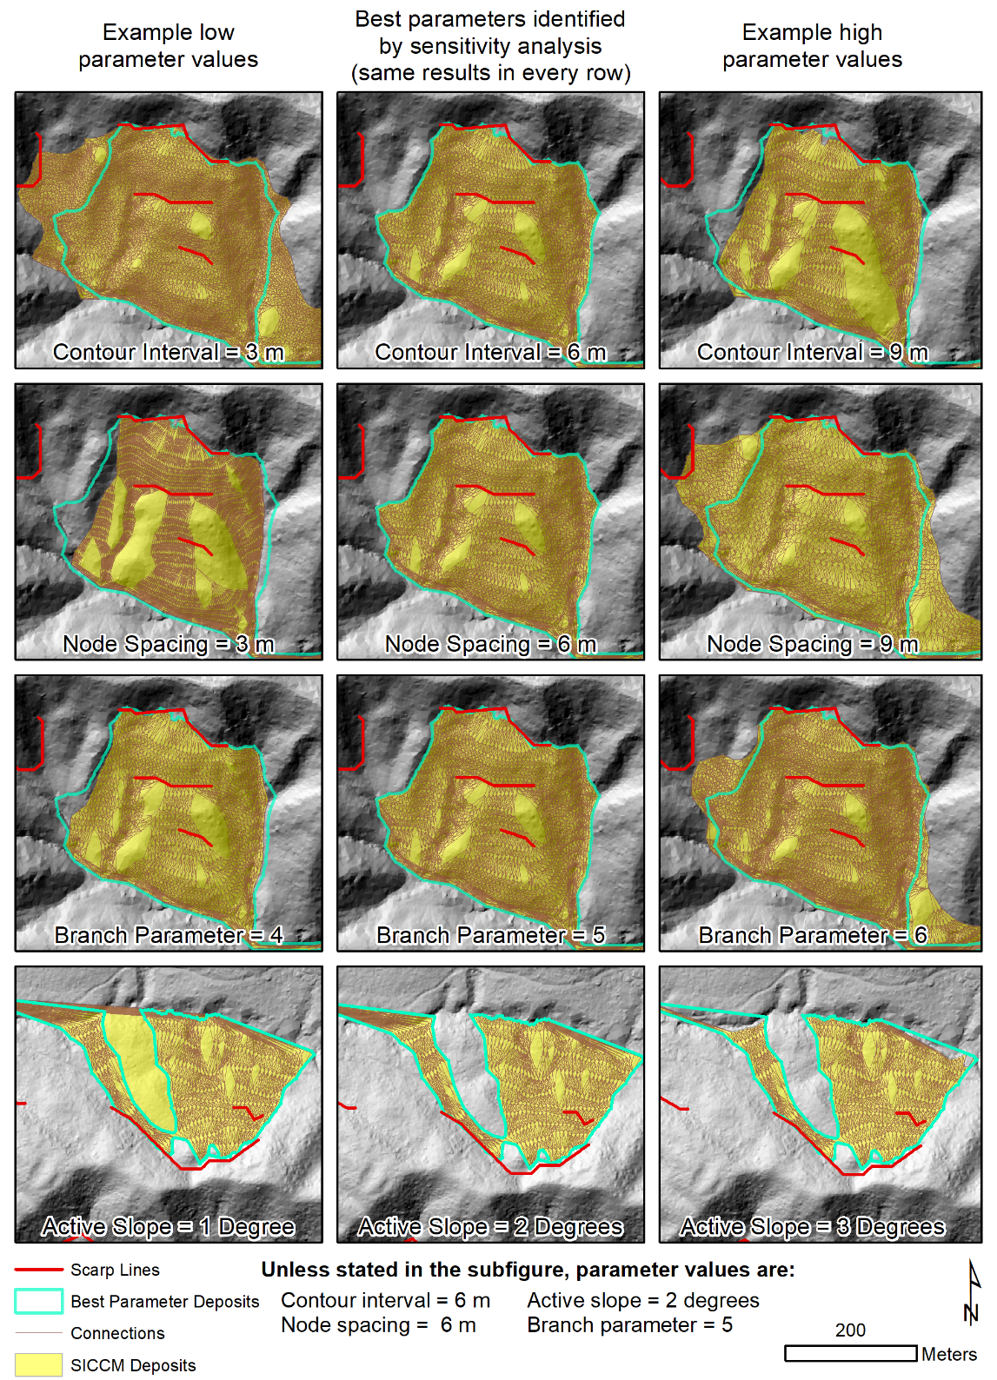
Influence of Deposit Mapping Parameters
Parameter values have a limited effect on the shape of deposits
This behavior is advantageous because it limits the likelihood of erratic results
Scarp Identification Deposit Mapping Risk Analysis
Notes:
The shape of deposits is not overly sensitive to the parameter choices
This observation means that users need not worry about their results being seriously wrong.

Slide 11
Accuracy Assessment Metrics
Metrics have been selected to evaluate:
Overall Accuracy (Accuracy)
Over prediction (Precision)
Under prediction (Recall)
Expert inventories are considered as “truth”
Example 1
Accuracy
Precision
Recall
Example 2
Accuracy
Precision
Recall
Area Evaluated
SICCM Deposits
Expert Deposits
Scarp Identification Deposit Mapping Risk Analysis
Notes:
To determine the best set of the four parameters, SICCM results were compared against a manually drawn inventory.
The ability of SICCM to map the manual deposits was evaluated using Accuracy, precision, and recall.
Each measure is meant to capture a specific trend in behavior, including overall accuracy, under prediction, and over prediction
No single measure is perfect (as shown in the figure). Each example is a poor example of mapping, but some measures still perform well.
More information can be found at https://en.wikipedia.org/wiki/Precision_and_recall - A decent explanation

Slide 12
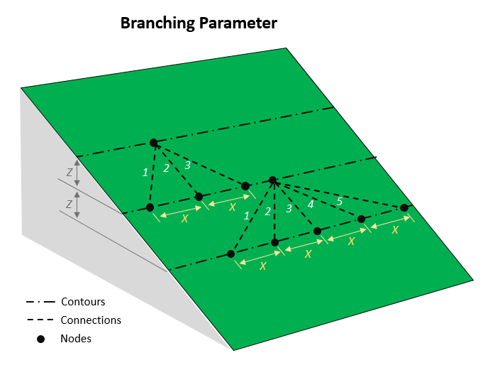
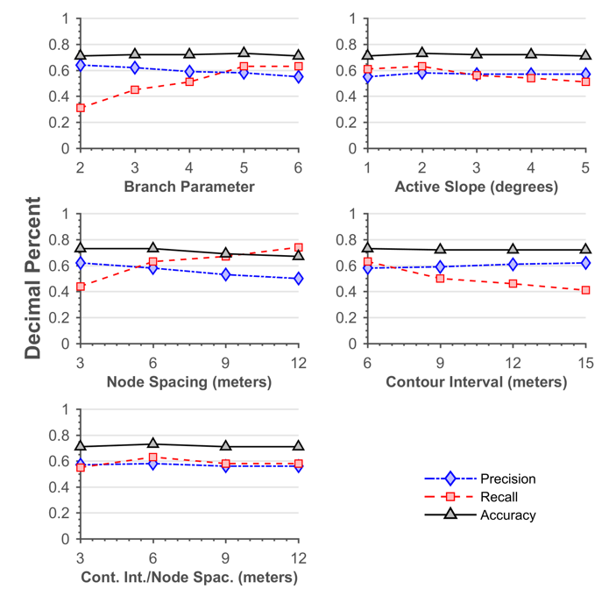
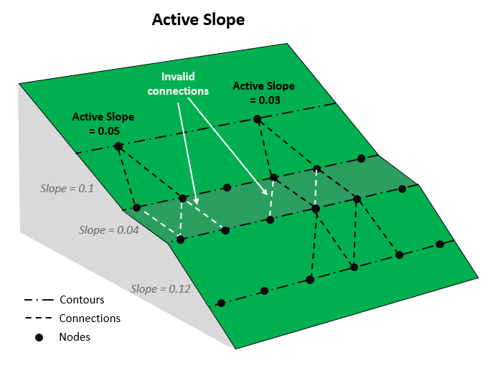
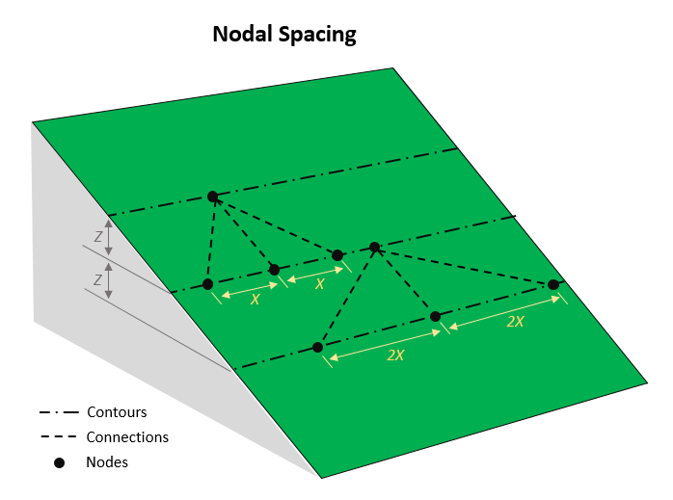
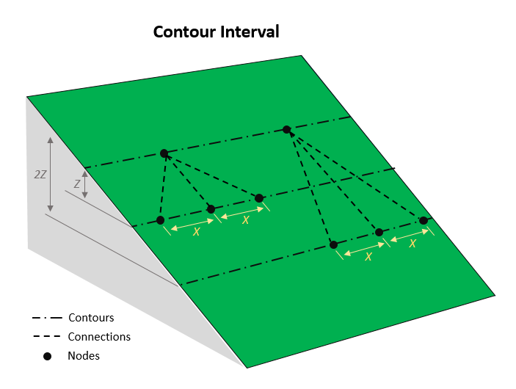
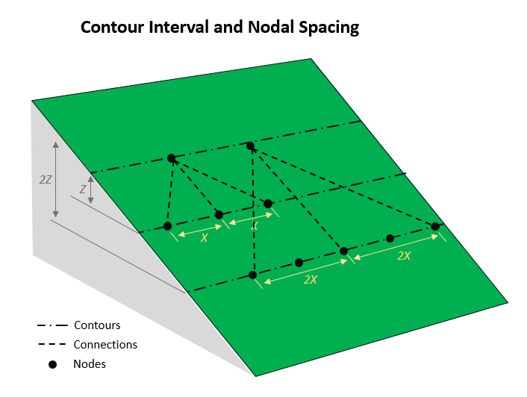
Influence of Parameters on Accuracy
Notes:
The four parameters were varied, and their results were compared against the manual deposits.
The comparison shows that accuracy is generally stable, and that over and under prediction are inversely related.
Because of the inverse relationship, users need to choose a compromise between the two sides, or they will need to choose a side that best fits their desired application.
If the user wants to capture most landslide deposits, then they may need to accept some over prediction – If the user wants to be very confident in the deposits that they have mapped, then they may need to accept some under prediction.

Slide 13
Risk Mapping Overview (from Leshchinsky et al. 2018)
Risk Component | Treatment
Hazard | The deposits of deep-seated landslides are unstable and represent a likely setting for shallow landslides Deep-seated landslides may reactivate during a wet winter season or during a large earthquake
Exposure | The spatial correspondence of landslide extents with roads and other infrastructure
Vulnerability | The cost of and time required to rebuild highway The economic loss due to reroutes and delays within the transportation network
Hazard
RISK
Exposure
Vulnerability
Scarp Identification Deposit Mapping Risk Analysis
Notes:
Risk is a combination of several factors – in this case, we have defined those factors as hazard, vulnerability, and exposure
The table shows how each factor is dealt with by this methodology

Slide 14
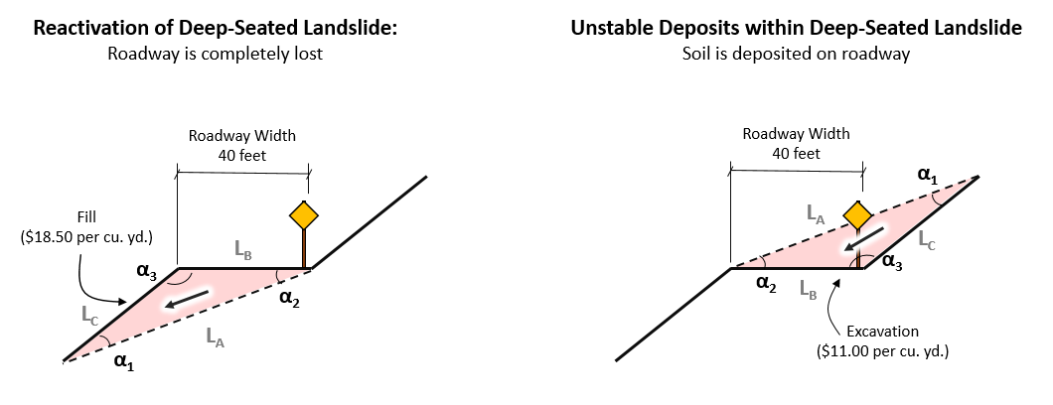
Hazard Component
Slope failures are assumed to occur – a deviation from normal landslide hazard analyses.
Unstable blocks within the landslide, and not the landslide itself, are considered.
Hazard severity is measured by volume of soil needing to be excavated or placed.
A planar shear plane and simplified geometry are assumed to enforce conservative estimates.
Scarp Identification Deposit Mapping Risk Analysis
Notes:
Hazard typically refers to some extreme event, be it precipitation, seismic, or something else. In this case, with no knowledge of a specific hazard, we assume the hazard to be that landslide deposits are loosely consolidated deposits that are likely to fail again.

Slide 15
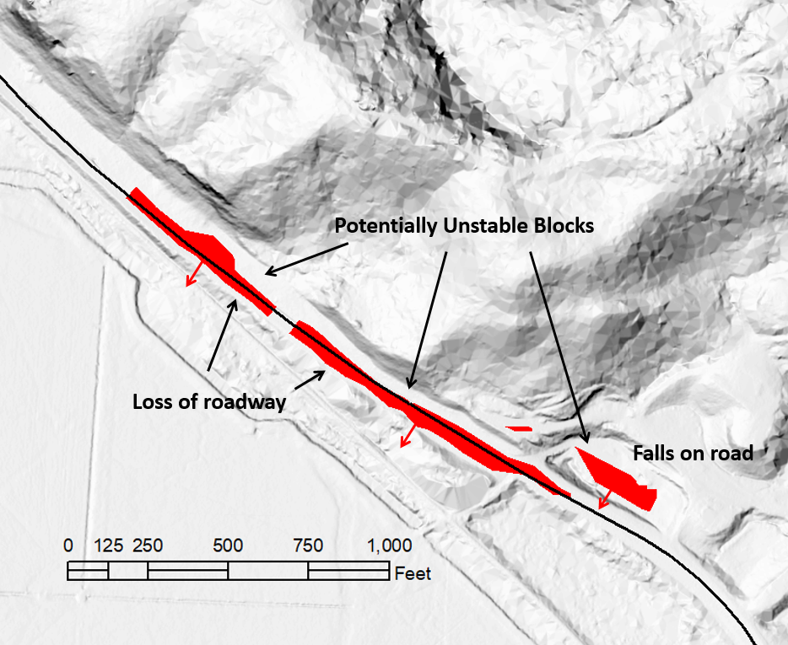
Exposure Component
Two relationships between the highway and landslide are considered:
Unstable soil falls onto roadway, requiring excavation.
Unstable slopes or embankments fail under roadway, requiring fill and reconstruction
Scarp Identification Deposit Mapping Risk Analysis
Notes:
Exposure is broken into two scenarios:
The unstable soil falls onto the roadway
The slope or embankment underlying the road collapses, and the roadway is lost
The first scenario is often the most common, while the second scenario tends to be the most expensive and time consuming to repair

Slide 16
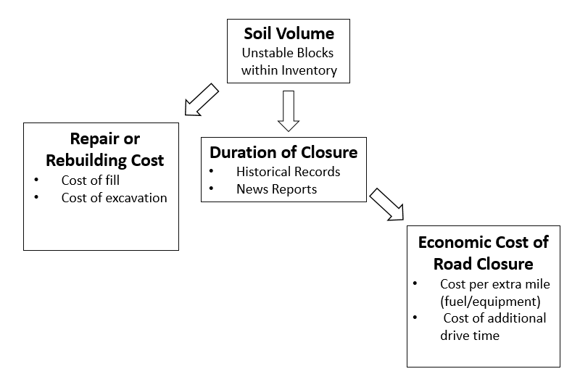
Vulnerability Component
Several measures are used to reflect what is lost following a landslide.
Relating the landslide to the road network is critical for the prioritization of repairs and maintenance.
Scarp Identification Deposit Mapping Risk Analysis
Notes:
Vulnerability considers whether or not a road matters. If a low-use road with only recreational traffic is damaged, the ultimate evaluation of risk should be less than for a busy logging road.

Slide 17
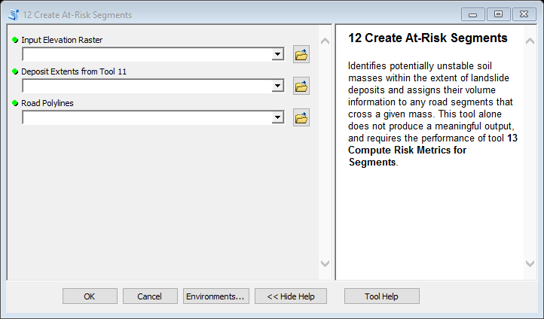
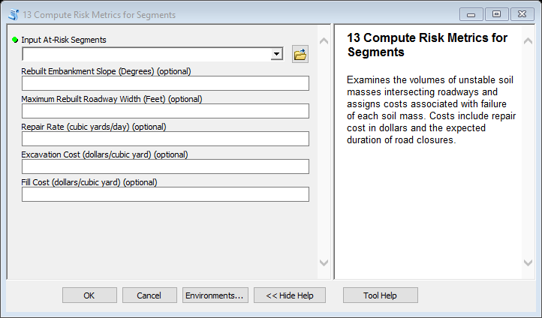
The Tools
1. Identify unstable geometry in SICCM inventory
2. Compute customized risk values for the unstable blocks
Scarp Identification Deposit Mapping Risk Analysis
Notes:
The risk analysis portion of the SICCM toolbox is broken down into two tools.
The first tool finds unstable soil masses to which the road may be exposed
The second tool applies user-defined estimates of repair costs and times to assign a total cost of failure to the soil masses

Slide 18
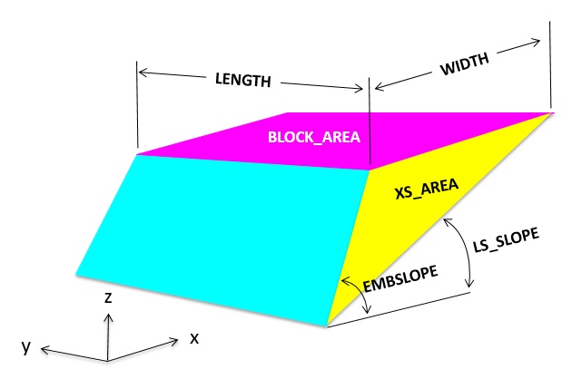
Risk Analysis Products
Landslide Deposits
At-Risk Segments
Notes:
The tools identify unstable blocks and approximate them as prisms
Roads corresponding to the unstable blocks are called at-risk segments
Attributes are assigned to each at-risk segment based on the volume of each unstable mass

Slide 19
Review of Toolbox
1
The SICCM Toolbox maps landslide scarps and deposits
The risk analysis portion of the toolbox identifies at-risk roads crossing landslide deposits
At-risk roads are given dollar and time cost estimates that quantify the severity of landslide risks that they face
2
3
Scarp Identification Deposit Mapping Risk Analysis
Notes:
The SICCM Toolbox maps landslide scarps and deposits
The risk analysis portion of the toolbox identifies at-risk roads crossing landslide deposits
At-risk roads are given dollar and time cost estimates that describe the significance of the corresponding failure

Slide 20
Acknowledgements
This presentation was prepared with the support of United States Department of Agriculture Forest Service Grant 17-CS-11015600-008
In accordance with Federal law and U.S. Department of Agriculture policy, this institution is prohibited from discriminating on the basis of race, color, national origin, age, or disability
References:
Burns, W.J., Madin, I.P., 2009. Protocol for Inventory Mapping of Landslide Deposits from Light Detection and Ranging (lidar) Imagery. Portland, OR.
Burns, W.J., Mickelson, K.A., 2016. DOGAMI Special Paper 48, Protocol for deep landslide susceptibility mapping. Portland, OR.
Chen, W., Li, X., Wang, Y., Chen, G., Liu, S., 2014. Forested landslide detection using LiDAR data and the random forest algorithm: A case study of the Three Gorges, China. Remote Sens. Environ. 152, 291–301. https://doi.org/10.1016/j.rse.2014.07.004
Highland, L.M., Bobrowsky, P., 2008. The landslide handbook—A guide to understanding landslides [WWW Document]. USGS Circ. 1325. URL https://pubs.usgs.gov/circ/1325/

